Slide 1
Cultural Significance
Explain how building design should change based on the expected occupants
Identify code requirements that are culturally dependent

Slide 2
Historic Fire
Notre Dame

Slide 3
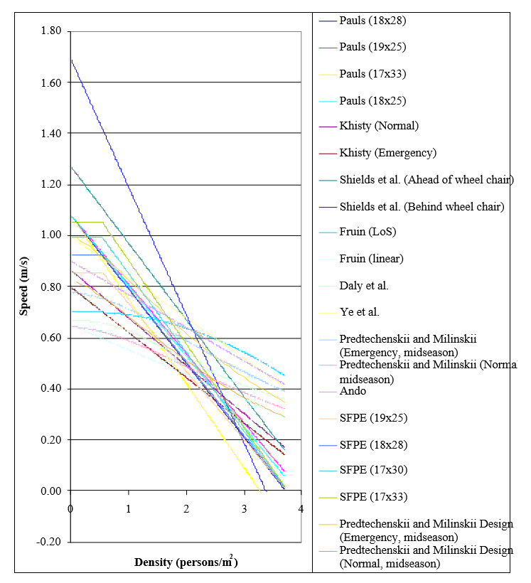
Underlying Assumptions
Data primarily from relatively few locations
Significant variation

Slide 4
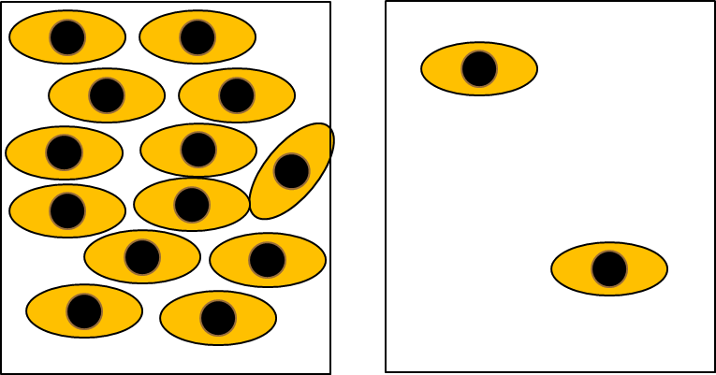
Underlying Assumptions
Density drives flow
At lowest levels people free to choose own speed
Spacing is culturally dependent

Slide 5

Building Codes
Use factors
Determined based on observations of actual buildings
Change with time
Spiral stairs
NFPA 5000: Spiral stairs shall turn such that descending users have the outer handrail on their right side

Slide 6

Societal Norms
Gender
Some studies found differences in movement speeds, others have not
Potential correlation to clothing
Interpersonal spacing
Passing and merging
Deference behavior
Exit choice

Slide 7
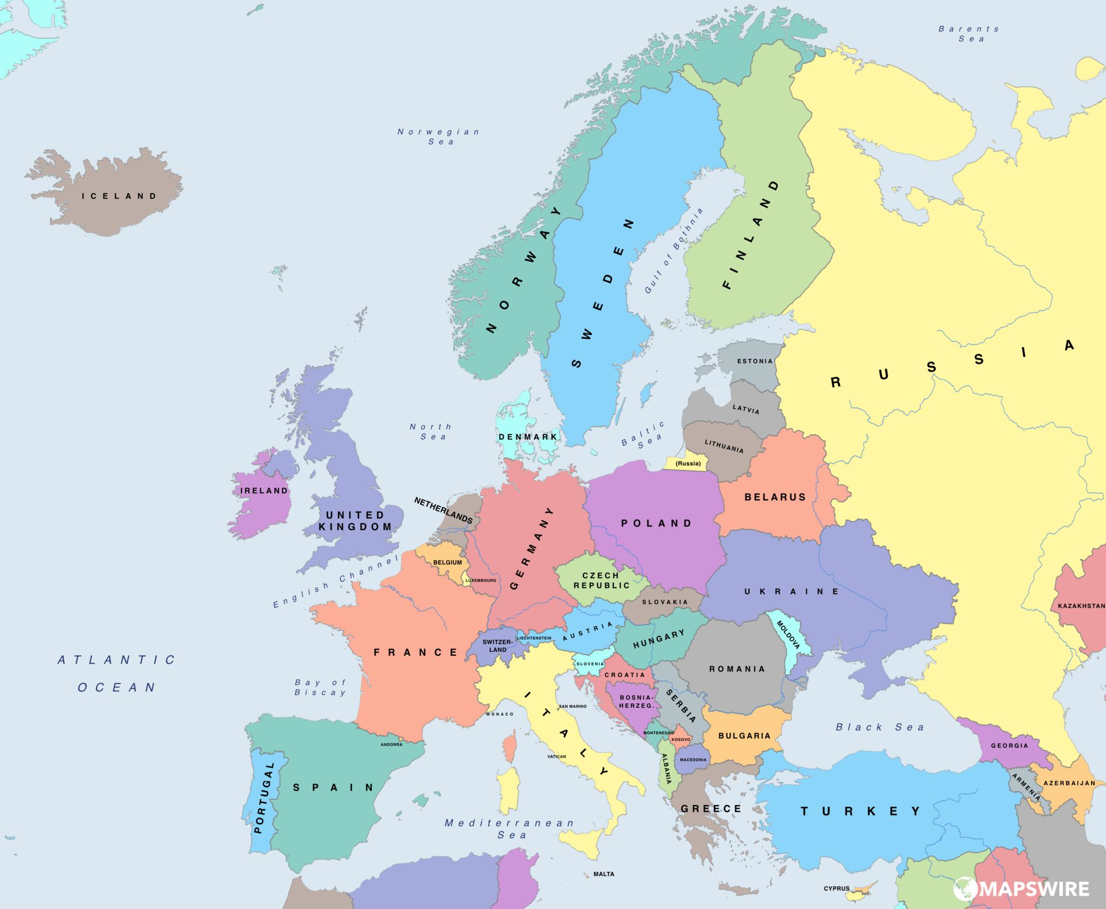
Fire Experience
Project BeSeCu
Library evacuations from multiple European countries
Statistically different results

Slide 8
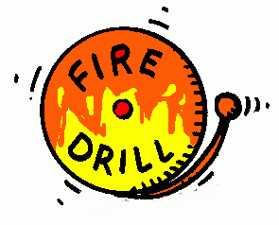
Fire Experience
Differences in fire safety training in schools- sometimes within country
Differences in pre-evacuation time
Differences in actions taken
Difference in perceived severity

Slide 9
Impact
Building design
Refuge floors
Vestibules
Numbers in codes
Speeds
Clothing
Density
Fitness
Interactions
Merging
Deference
Response
Pre-evacuation
Training
Behavioral norms
Exit choice
Exits designated for others
Familiarity

Slide 10
Culturally Significant Buildings
Concerns beyond life safety
Building more than just a building
May not be obvious what the significance is to outsiders

